Slide 1
USAS 2022 Calendar Year End

Slide 2
2022 Calendar Year End Agenda
Pre-Closing Procedures
Calendar Year End Close
1099-NEC & 1099-MISC Procedures

Slide 3
Due Dates of Forms & Instructions
Please have 1099 File sent to ACCESS no later than
January 13, 2023
ACCESS will file all forms by January 31, 2023
In order to do so all files must be submitted to us by the January 13th deadline

Slide 4
Due Dates of Forms & Instructions
Filing of 1099 – NEC
A copy of Form 1099-NEC should also be sent to your vendors and independent contractors by January 31, 2023.
Filing of 1099-MISC
A copy of Form 1099-MISC should be sent to the MISC recipients by January 31, 2023.
General Instructions for Certain Information Returns
https://www.irs.gov/instructions/i1099gi

Slide 5
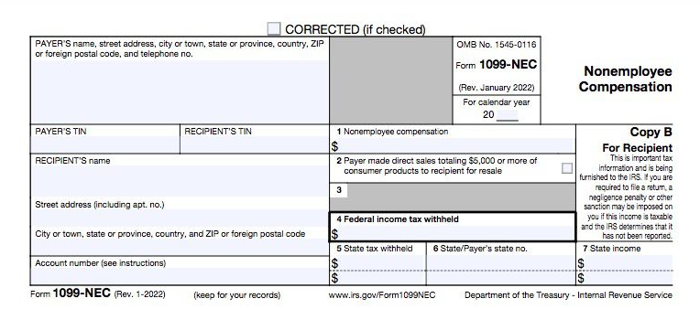
1099-NEC
Non Employee Compensation
Box 1 - Amount of
nonemployee
compensation.
Box 4 - Amount to
comply with backup
withholding
requirements.
Boxes 5-7 - Amount of any state withholding.

Slide 6
1099-NEC
Non Employee Compensation
Form 1099-NEC
Payments of $600 or more for services of nonemployees and attorneys
Non-Employee Compensation is Reported in Box 1
There is no automatic extension available for the 1099-NEC form.
A request for an extension can be submitted by paper Form 8809, refer to Part A, Sec. 8, Extensions
Prior Year Corrections
Corrections from prior years should be reported on prior year forms

Slide 7
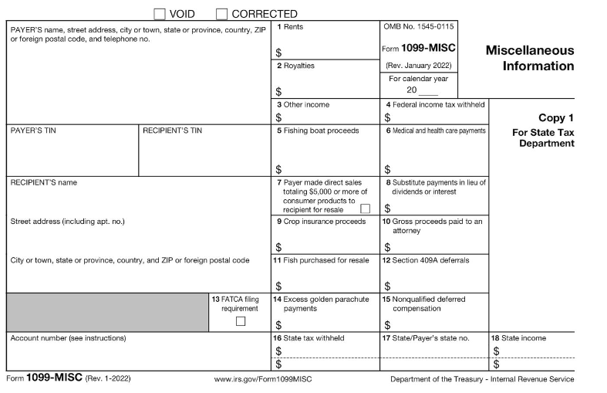
1099-MISC Information
Payer made direct sales of $5,000 or more (checkbox) in box 7
Crop insurance proceeds– Box 9
Gross proceeds to an attorney – Box 10
Section 409A deferrals-Box 12
Nonqualified deferred compensation income is reported in box 14
Boxes 15, 16, and 17 report state taxes withheld, state identification number, and amount of income earned in the state, respectively.

Slide 8
1099-NEC
File Form 1099-NEC, Nonemployee Compensation, for each person in the course of your business to whom you have paid the following during the year.
At least $600
Services performed by someone who is not your employee (including parts and materials) (box1)
Cash payments for fish (or other aquatic life) you purchase from anyone engaged in the trade or business of catching fish (box 1)
Payments to an attorney (box 1)
You must also file Form 1099-NEC for each person from whom you have withheld any federal income tax (report in box 4) under the backup withholding rules regardless of the amount of the payment.

Slide 9
1099-MISC
File Form 1099-MISC, Miscellaneous Information, for each person in the course of your business to whom you have paid the following during the year.
At least $10 in royalties (see the instructions for box 2) or broker payments in lieu of dividends or tax-exempt interest (see the instructions for box 8).
At least $600 in:
Rents (box 1);
Prizes and awards (box 3);
Other income payments (box 3);
Generally, the cash paid from a notional principal contract to an individual, partnership, or estate (box 3);
Any fishing boat proceeds (box 5);
Medical and health care payments (box 6);
Crop insurance proceeds (box 9);
Gross proceeds paid to an attorney (box 10) (see Payments to attorneys, later);
Section 409A deferrals (box 12); or
Nonqualified deferred compensation (box 15).

Slide 10
Payments to Attorney
1099 NEC
Payments to attorneys. The term “attorney” includes a law firm or other provider of legal services. Attorneys’ fees for $600 or more paid in the course of your trade or business are reportable in box 1 of form 1099-NEC, under section 6041A(a)(1)
1099 MISC
Gross proceeds paid to attorneys
Under section 6045(f), report in box 10 payments that:
Are made to an attorney in the course of your trade or business in connection with legal services, but not for the attorney’s services, for example as in a settlement agreement;
Total $600 or more: and
Are not reportable by you in box 1 of Form 1099 NEC File Form 1099-NEC, Nonemployee Compensation, for each person in the course of your business to whom you have paid the following during the year.

Slide 11
CYE – Things that can be done now
Review & Verify Vendors
Vendors Tax ID Type (SSN or EIN)
Vendors ID #
Vendors Type 1099
Vendors 1099 Location (address)

Slide 12
CYE – Things that can be done now
1099 Vendor Information located under Core / Vendors
1099 section
Locations

Slide 13
Edit Vendor Details
Vendor Names/Addresses
Name/address on W-9 form may be different than name/address for checks

Slide 14
Options to Review 1099 Data
Vendor’s Grid
Core > Vendors
SSDT 1099 Vendor Report
Report Manager
1099 Extract Report
Periodic > 1099 Extracts > Print 1099 Report

Slide 15
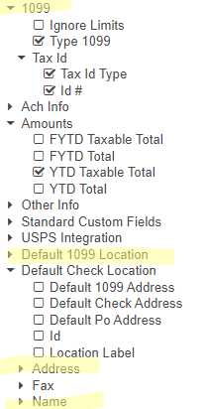
Vendors Grid-MORE Button
1099 Info
Type 1099
Tax ID Type
Id#
Default 1099 Location
Name
Address
Use the Report button to save your filtered grid settings

Slide 16
Vendors Grid
View the Grid Details
IRS Interactive TIN/Name Matching program
Optional
Can be used to check if SSN or EIN should be used by matching up the name and number combo on the IRS interactive site for immediately verified.
https://www.irs.gov/tax-professionals/taxpayer-identification-number-tin-matching

Slide 17
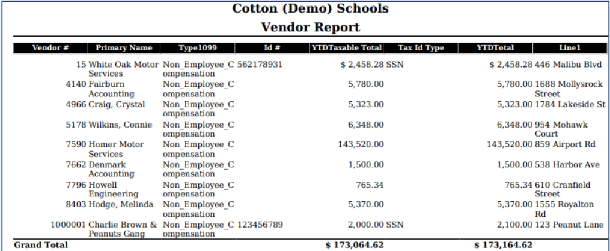
Vendors Grid – Report

Slide 18
Verify 1099 Data
Verify Vendors who should receive 1099s and their YTD amounts
Identify 1099 Vendors and non-1099 vendors
1099 Type
Vendors qualifying YTD Taxable Total

Slide 19
Vendors Grid – 1099 Vendors
Use the MORE button: Tax ID Type, ID#, & Type 1099
Use Filters:
Active: =true
Type 1099 : <> non 1099 (excludes non-1099 types)
YTD Taxable Total: >=600
Use the Type 1099 to filter on a specific 1099 type (i.e. Royalty Payments).
Use the YTD Taxable Total to filter on amounts
Use the Report button to print and/or save your filtered grid settings

Slide 20
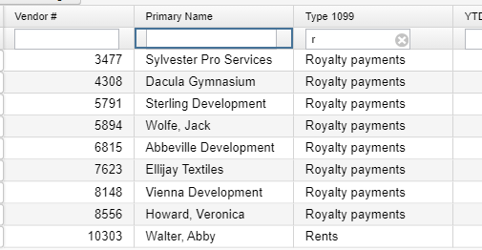
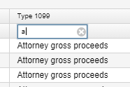
Review ‘Types’ using Vendors Grid
Use the Vendors Grid to filter Type 1099
Use the Report button to save your filtered grid settings

Slide 21
Grid – 1099 Vendors – Advanced Query
Advanced Query can also be used to locate 1099 Vendors
Active - Equals - True
Type 1099 - Not equals - Non 1099
YTD Taxable Total – Greater or equal – 600
Apply Query
Save Query to use again if you choose

Slide 22
Vendors Grid – Non 1099 Vendors
Check Non-1099 Vendors with qualifying YTD activity by filtering:
Active: true
Type 1099 : = non 1099
YTD Taxable Total: >=600
Use the Report button to save your filtered grid settings

Slide 23
Grid – Non 1099 Vendors – Advanced Query
Use Advanced Query to Review Vendors marked NOT to receive a 1099
Change Filter TYPE 1099 to Equals “Non 1099”
Change YTD Taxable Total >=600

Slide 24
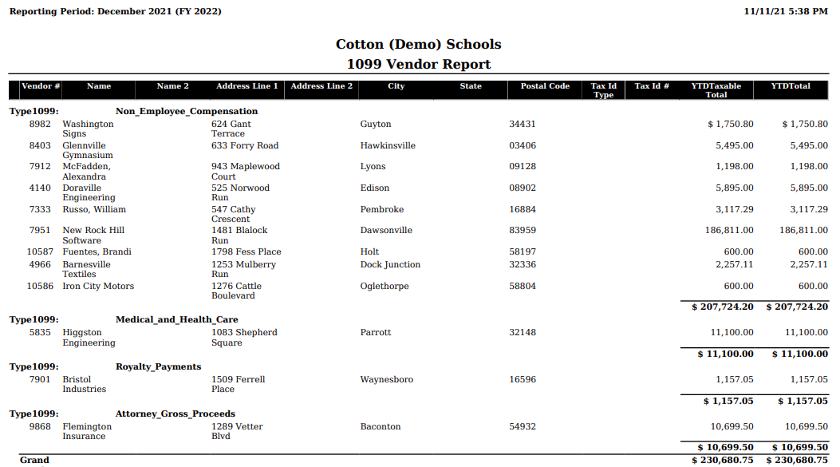
SSDT 1099 Vendor Report

Slide 25
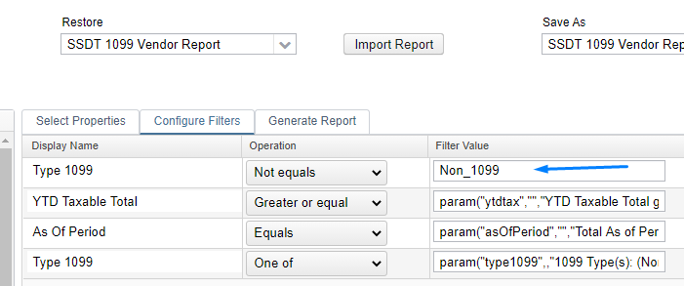
SSDT 1099 Vendor Report
Can Modify Configure Filters to run for specified 1099 Types

Slide 26
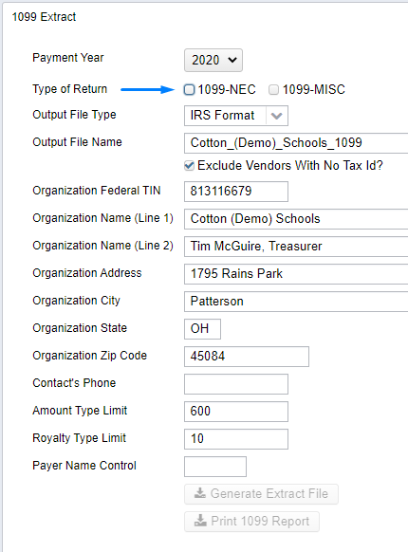
1099 Extracts Report
Periodic Menu > 1099 Extract > Print 1099 Report
Used to verify data prior to creating Extract File
Defaults to Exclude Vendors With No Tax Id
Must pick Type of Return before Print 1099 Report available
Subtotals by 1099 Type
NOTE: This report can NOT be run until the
Posting Period for December has been created.

Slide 27
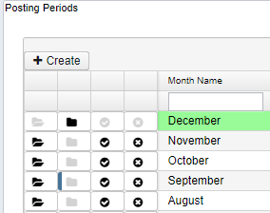
Review Posting Periods
Because the 1099 Extract report cannot be run unless December is created, now is a good time to review your open Posting Periods.
As months are closed, reports are created in File Archive.
Wait for the reports to complete before closing the next
month.

Slide 28
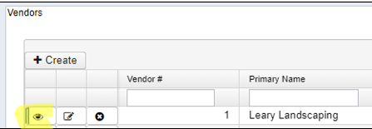
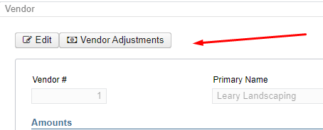
Vendor Adjustments
If a manual adjustment is needed on the Vendor’s YTD Amount
View the Vendor under Core
Click on Vendor Adjustments

Slide 29
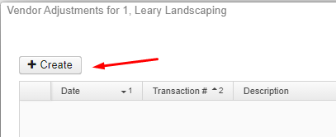
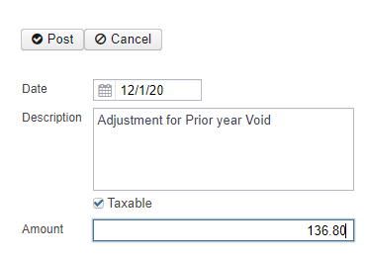
Vendor Adjustments
Create a new Adjustment
Enter Adjustment info
Amount can be positive or negative
Check Taxable box to update YTD Taxable Total

Slide 30
Month End Closing
Proceed with closing out for the month of December
Enter all transactions for the current month
Attempt to reconcile USAS records with your bank(s)
Perform Bank Reconciliation Procedure (link is provided in the CYE checklist)
Under Periodic menu, select ‘Cash Reconciliation’ to enter your cash reconciliation information for the month
Generate the SSDT Cash Summary report and the SSDT Financial Detail report
The detail report may be run for the month in order to compare MTD totals to the Cash Summary report for December. Totals should match.
If totals agree . . . You are balanced & may proceed

Slide 31
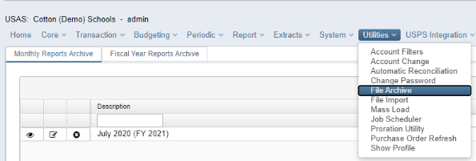
Month End Closing
Optional - Run a Spending Plan Summary report
The Spending Plan Summary will generate a report in the same line number format as the Five-Year Forecast. It will list the current periods actual amount for each line number and will include a FYTD total
Manually run and review any desired reports
When the month is closed, December will be
created in File Archive

Slide 32
Monthly Report Bundle
Cash Reconciliation Report for the month
Monthly Balance Report
Cash-related Reports: Cash Summary Report / Financial Detail Report for the month / Financial Summary by Fund
Budget-related Reports:
Budget Summary / Budget Account Activity Report (for the month)
Budget Transactions Summarized by Appropriation / Appropriation Summary Report
Negative Budget Report / Negative Appropriation Account Report / Error Corrections & Supplies Distributions
Revenue-related Reports: Revenue Summary / Revenue Account Activity report for the month
PO-related Reports: Purchase Order Detail Report for the month / Outstanding Purchase Order Detail Report /Transaction Ledger-Vendor Activity / Vendor Listing
Disbursement-related Reports: Detailed Check Register / Outstanding Disbursement Summary Report
Receipt-related Reports:
Receipt Ledger Report for the month / Reduction of Expenditure Ledger Report for the month
Refund Ledger Report for the month / Void Refund Ledger Report
Transfer Advance Summary / Fund to Fund Transfer Ledger Report
User Listing AOS Extract

Slide 33
Monthly Reports Archive
Will automatically run when Posting Period is closed.
Wait until the bundle is complete before closing another month
Reports can be viewed under Utilities>File Archive
Individual reports cannot be deleted - only entire monthly bundle

Slide 34
Calendar Year End Closing
Generate any desired Calendar Year End Reports (i.e. Workers Comp)
The Proration Utility program generates a spreadsheet which may be used to assist in calculating premium amounts for Worker's Compensation payments.
Utilities > Proration Utility
Choose Time Period – i.e. Calendar Year To Date
Choose Filter – i.e. Workers Comp ** Must be set up prior to running proration utility
(ex. Expenditure object 1%% in filter)
Enter File Name of your spreadsheet – i.e. Workers Comp 2021
Can run by Appropriation
Click Create to create spreadsheet
Enter amount to prorate in column B1
Download file to save in excel

Slide 35
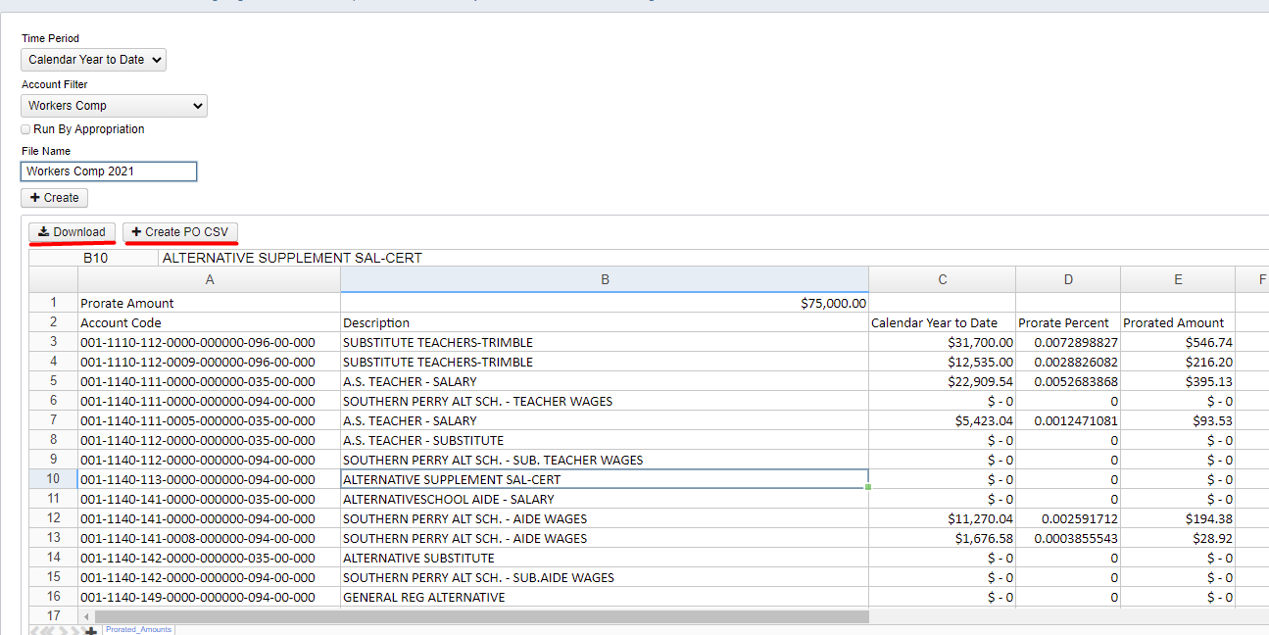
Example of Proration Utility

Slide 36
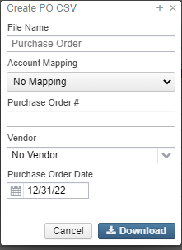
Example of Proration Utility
The Create PO CSV option can be used to download the information to a spreadsheet formatted with columns that can be use with the Purchase Order Import option. When generating the PO CSV, a window will pop up with the following options:
File Name: Name used for the CSV file that will be created.
Account Mapping: Used to map accounts in Proration Utility grid to different account codes if desired.
The Account Code Mappings should be pre-configured on the Account Code Mapping grid to appear in the drop down. (ex. Can be used to map salary account codes to benefit account codes)
Purchase Order #: A purchase order number can be assigned. If this field is left blank, a purchase order will be automatically assigned when the file is imported.
Vendor: Select a vendor to be used on the PO. If a vendor is not assigned to the imported record, the Purchase Order will be marked as a Multi-vendor PO.
Purchase Order Date: Used to assign the date used on the Purchase Order
This information is used to generate the PO CSV. However, any information can be manually edited on the spreadsheet prior to importing if needed.

Slide 37
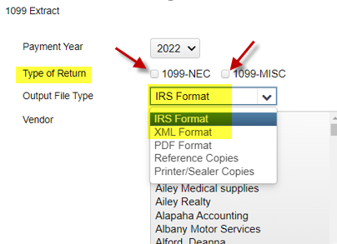
1099 Extracts
Once all 1099 data is verified, balanced and complete . . .
District runs the 1099 Extracts under the Periodic menu.
Output File Type: XML file
Used for printing 1099s with the Edge Software program
Output File Type: IRS format (TAP)
Used for IRS Submission
IMPORTANT!! Select both Types of Return prior to
running the extract.

Slide 38
1099 Extract Output
The IRS Format will create a file called:
Insert_District_Name_1099.tap
The XML Format will create a file called:
Insert_District_Name_1099.xml
Upload both to the
ACCESS Secure Transfer Site
https://secure.access-k12.org/login

Slide 39
Calendar Year End Closing
Core>Posting Periods – Close December
December reports will automatically generate in the Utilities>File
Archive> Monthly Reports Archive
Calendar Year End Reports will automatically generate in the
Utilities>File Archive>Calendar Year End Archive
Wait for the reports to complete.
District is now closed for the month & calendar year
Core>Posting Periods
Create new Posting Period for January

Slide 40
Calendar Year End Report Archive
When 1099 Extract options are run, a copy will be sent to the File Archive > Calendar Year Reports Archive section.
Separate tab under Utilities > File Archive
Recommendation: Add step to your CYE procedures for Districts to verify these files have been created.

Slide 41
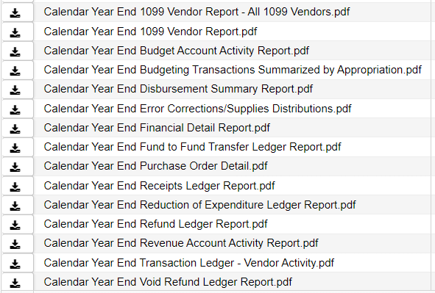
Calendar Year End Closing
When December is closed, reports will be generated:

